Slide 1


Azərbaycan Dövlət Neft və Sənaye Universiteti
Computer Architecture and Operating Systems

Slide 2
The construction of computer circuits is based on the branch of mathematics and symbolic logic called Boolean logic.
This area of mathematics deals with rules for manipulating the two logical values true and false.
It is used to construct circuits that perform operations such as
Adding numbers
Comparing numbers
Fetching instructions
These ideas are part of the branch of computer science known as hardware design, also called logic design.
Boolean Logic and Gates

Slide 3
It is easy to see the relationship between Boolean logic and computer design:
the truth value true could represent the binary value 1
the truth value false could represent the binary value 0
Thus anything stored internally as a sequence of binary digits can also be viewed as a sequence of the logical values true and false, and these values can be manipulated by the operations of Boolean logic.
Boolean Logic

Slide 4
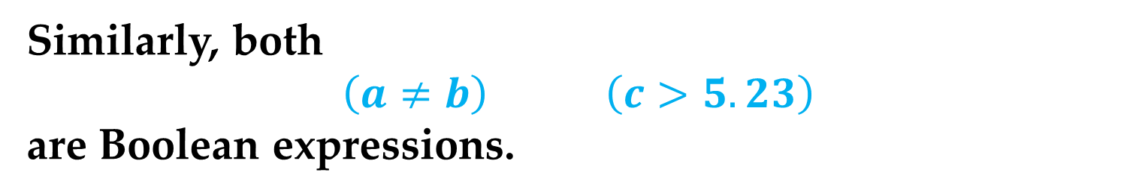
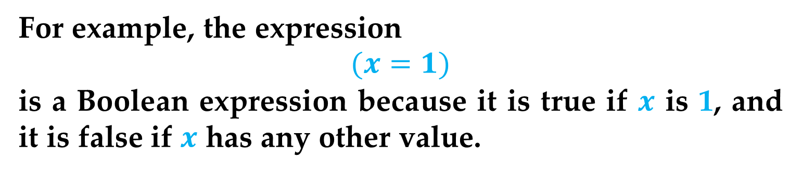
Let us define a Boolean expression as any expression that evaluates to either true or false.
For example, the expression
$$(x=1)$$
is a Boolean expression because it is true if $x$ is 1, and it is false if $x$ has any other value.
Similarly, both
$$\left(a≠b\right) \left(c>5.23\right)$$
are Boolean expressions.
In Boolean logic, the operations used to construct Boolean expressions are AND, OR, and NOT, and they map a set of (true, false) values into a single (true, false) result.
Boolean Logic

Slide 5
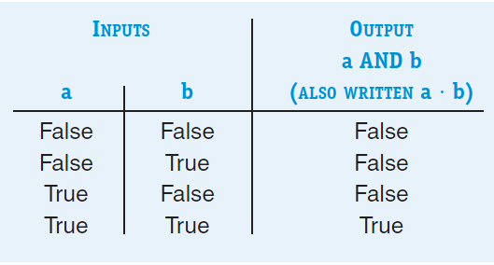
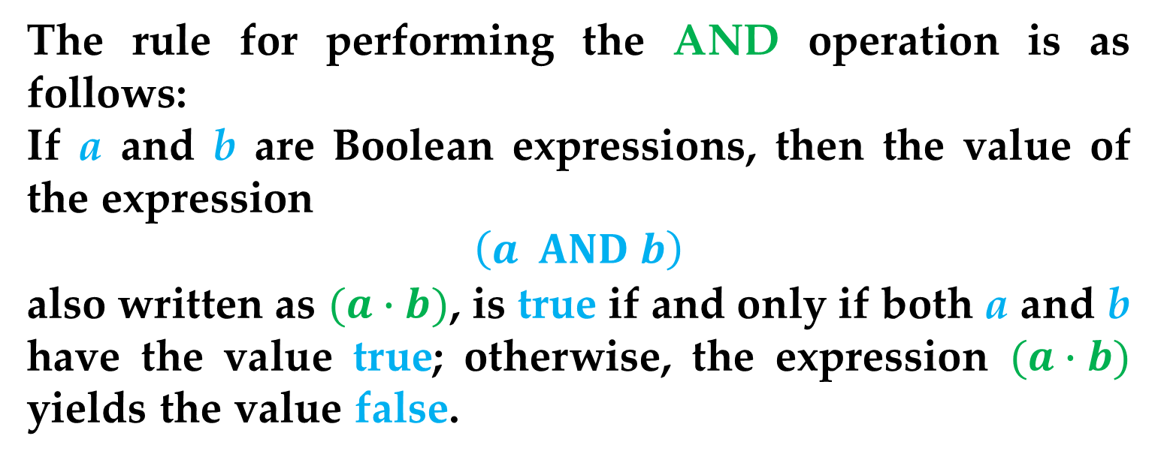
The rule for performing the AND operation is as follows:
If a and b are Boolean expressions, then the value of the expression
$$\left(a AND b\right)$$
also written as $(a∙b)$, is true if and only if both a and b have the value true; otherwise, the expression $(a∙b)$ yields the value false.
This idea can be expressed using a structure called a truth
table, shown next.
Boolean Logic

Slide 6
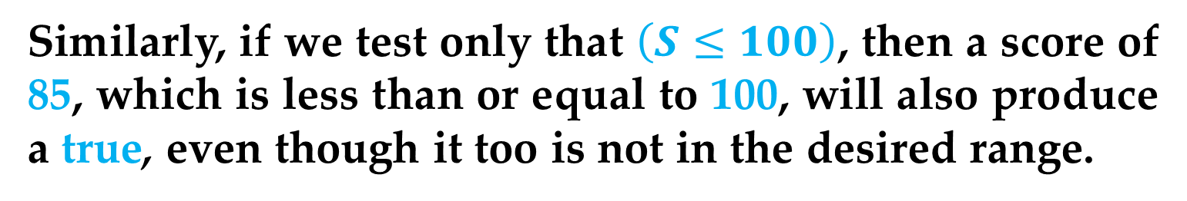
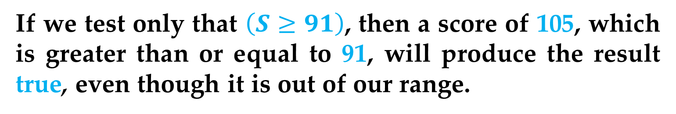
To illustrate the AND operation, imagine that we want to check whether a test score S is in the range 91 to 100 inclusive.
We wish to develop a Boolean expression that is true if the score is in the desired range and false otherwise.
But we cannot do this with a single comparison.
If we test only that $\left(S≥91\right)$, then a score of 105, which is greater than or equal to 91, will produce the result true, even though it is out of our range.
Similarly, if we test only that $\left(S≤100\right)$, then a score of 85, which is less than or equal to 100, will also produce a true, even though it too is not in the desired range.
Boolean Logic

Slide 7
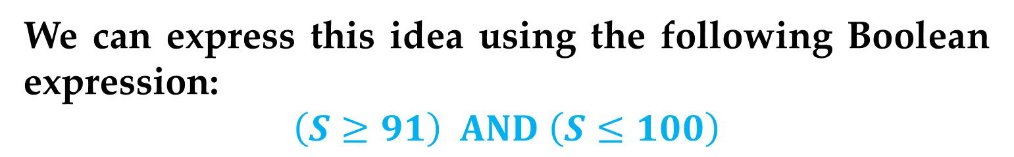
Instead, we need to determine whether the score S is greater than or equal to 91 AND whether it is less than or equal to 100.
Only if both conditions are true can we say that S is in the desired range.
We can express this idea using the following Boolean expression:
$$\left(S≥91\right) AND \left(S≤100\right)$$
Each of the two expressions in parentheses can be either true or false depending on the value of S.
However, only if both conditions are true does the expression evaluate to true.
Boolean Logic

Slide 8
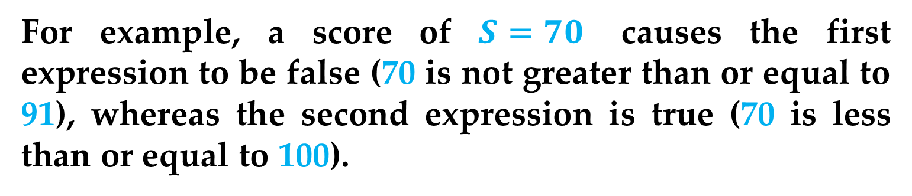
For example, a score of $S=70$ causes the first expression to be false (70 is not greater than or equal to 91), whereas the second expression is true (70 is less than or equal to 100).
The truth table below shows that the result of evaluating (false AND true) is false.
Thus, the overall expression is false, indicating (as expected) that 70 is not in the range 91 to 100.
Boolean Logic

Slide 9
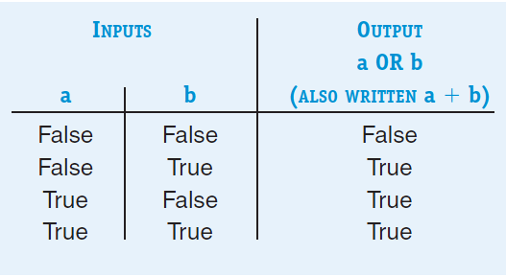
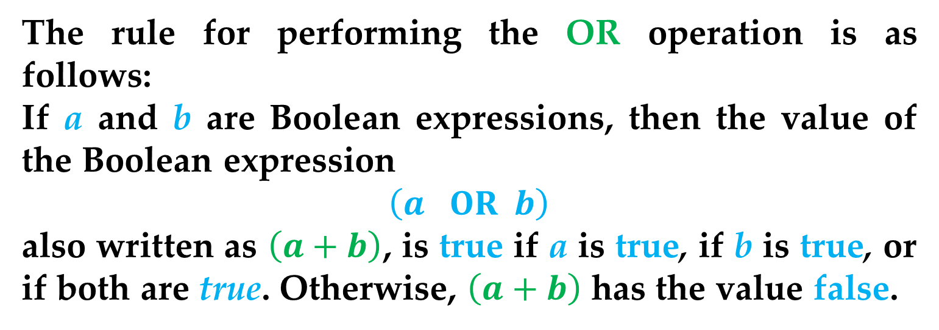
The rule for performing the OR operation is as follows:
If a and b are Boolean expressions, then the value of the Boolean expression
$$\left(a OR b\right)$$
also written as $\left(a+b\right)$, is true if a is true, if b is true, or if both are true. Otherwise, $\left(a+b\right)$ has the value false.
The truth table for OR is shown next.
Boolean Logic

Slide 10
To see the OR operation at work, imagine that a variable called major specifies a student’s college major.
If we want to know whether a student is majoring in either math or computer science, we cannot accomplish this with a single comparison.
The test
(major = ‘math’)
omits computer science majors, whereas the test
(major = ‘computer science’)
leaves out the mathematicians.
Boolean Logic

Slide 11
Instead, we need to determine whether the student is majoring in either math or computer science (or perhaps in both).
This can be expressed as follows:
(major = ‘math’) OR
(major = ‘computer science’)
If the student is majoring in either one or both of the two disciplines, then one or both of the two terms in the expression is true.
Referring to the truth table for OR, we see that
(true OR false), (false OR true), and (true OR true)
all produce the value true.
Boolean Logic

Slide 12
However, if the student is majoring, for example, in English, both conditions are false.
As the truth table for OR illustrates, the value of the expression
(false OR false) is false
meaning that the student is not majoring in either math or computer science.
Boolean Logic

Slide 13
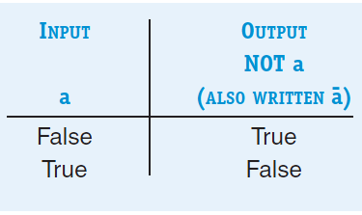
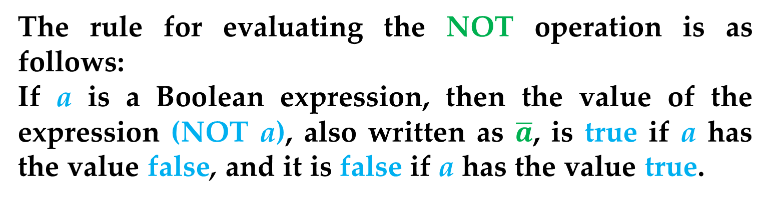
Unlike AND and OR, which require two operands and are therefore called binary operators, NOT requires only one operand and is called a unary operator.
The rule for evaluating the NOT operation is as follows:
If a is a Boolean expression, then the value of the expression (NOT a), also written as $\overline{a}$, is true if a has the value false, and it is false if a has the value true.
The truth table for NOT is shown next
Boolean Logic

Slide 14
For example, the expression
(GPA > 3.5)
is true if your grade point average is greater then 3.5.
The expression
NOT (GPA > 3.5)
is true only under the reverse conditions, that is when your grade point average is less than or equal to 3.5.
Note that besides AND, OR, and NOT, there are other Boolean operators such as XOR, NOR, and NAND.
Boolean Logic

Slide 15
Why have we introduced these Boolean operations in the first place?
In fact, the fundamental building blocks of a modern computer system (the objects with which engineers actually design) are not the transistors introduced, but the gates that implement the Boolean operations AND, OR, and NOT.
Boolean Logic

Slide 16
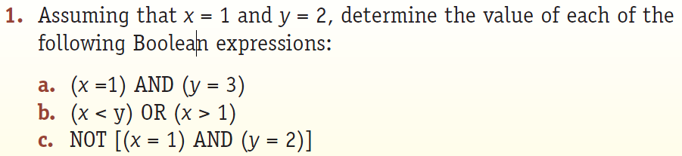
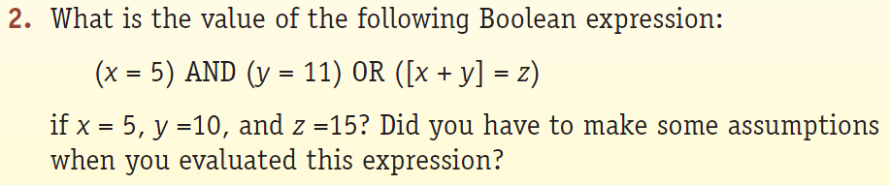
Practice Problems

Slide 17
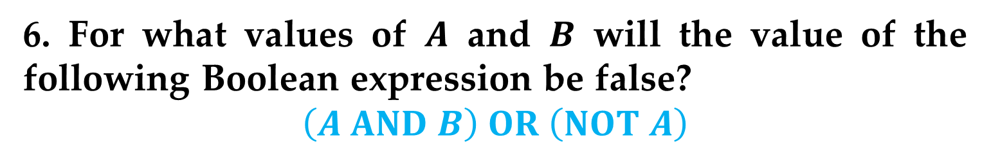
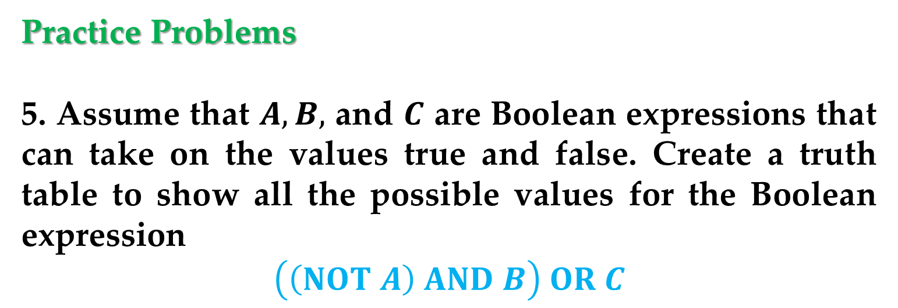
Practice Problems
5. Assume that $A, B,$ and $C$ are Boolean expressions that can take on the values true and false. Create a truth table to show all the possible values for the Boolean expression
$$\left(\left(NOT A\right) AND B\right) OR C$$
6. For what values of $A$ and $B$ will the value of the following Boolean expression be false?
$$\left(A AND B\right) OR \left(NOT A\right)$$
Boolean Logic

Slide 18
A gate is an electronic device that operates on a collection of binary inputs to produce a binary output.
That is, it transforms a set of (0,1) input values into a single (0,1) output value according to a specific transformation rule.
Although gates can implement a wide range of different transformation rules, the ones we are concerned with in this lecture are those that implement the Boolean operations AND, OR, and NOT.
Gates (not Bill)

Slide 19
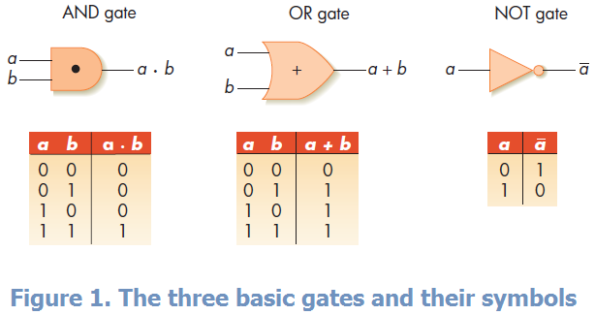
As shown in Figure 1, these gates can be represented symbolically, along with the truth tables that define their transformation rules.
These three electronic gates directly implement the corresponding Boolean operation.
Gates

Slide 20
For example, an AND gate has its output line set to 1 (set to some level of voltage that represents a binary 1) if and only if both of its inputs are 1.
Otherwise, the output line is set to 0 (set to some level of voltage that represents a binary 0).
This is functionally identical to the rule that says the result of (a AND b) is true if and only if both a and b are true; otherwise, (a AND b) is false.
Similar arguments hold for the OR and NOT.
Gates

Slide 21
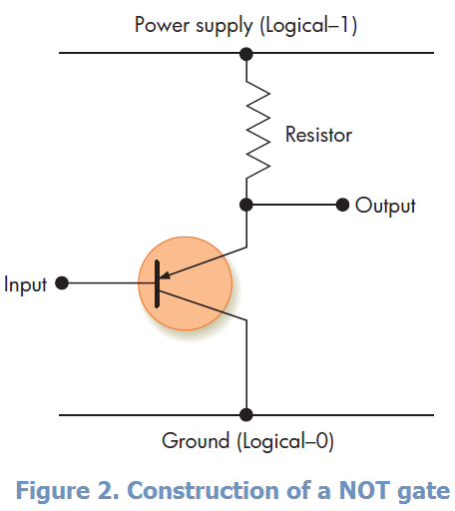
NOT Gate
A NOT gate can be constructed from a single transistor, as shown in Figure 2.
The collector is connected to the power supply (logical-1) and the emitter is connected to the ground (logical-0).
Gates

Slide 22
If the input to the transistor is set to 1, then the transistor is in the ON state, and it passes current through to the ground.
In this case the output voltage of the gate is 0.
If the input is set to 0, the transistor is in the OFF state, and it blocks passage of current to the ground.
Instead, the current is transmitted to the output line, producing an output of 1.
Thus, the value appearing on the output line of Figure 2 is the complement — the NOT — of the value appearing on the collector, or input line.
Gates

Slide 23
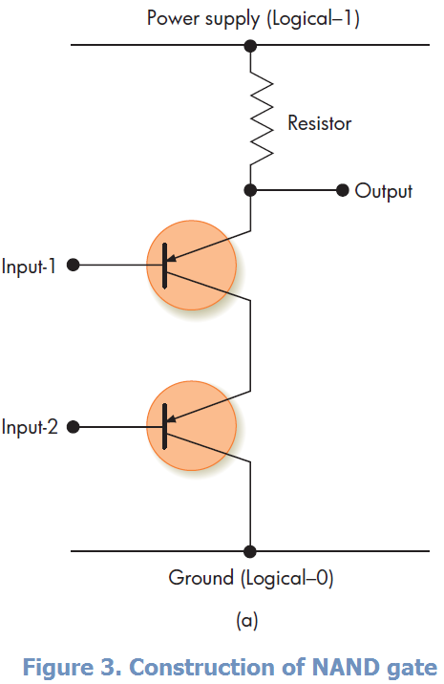
AND Gate
To construct an AND gate, we connect two transistors in series, as shown in Figure 3.
The collector line of transistor 1 connected to the power supply (logical-1) and the emitter line of transistor 2 connected to ground (logical-0).
Gates

Slide 24
If both input lines, called Input-1 and Input-2 in Figure 3, are set to 1, then both transistors are in the ON state, and the output will be connected to ground, resulting in a value of 0 on the output line.
If either (or both) Input-1 or Input-2 is 0, then the corresponding transistor is in the OFF state and does not allow current to pass, resulting in a 1 on the output line.
Thus, the output of the gate in Figure 3 is a 0 if and only if both inputs are a 1; otherwise, it is a 1.
This is the exact opposite of the definition of AND – a gate called NAND, an acronym for NOT AND.
Gates

Slide 25
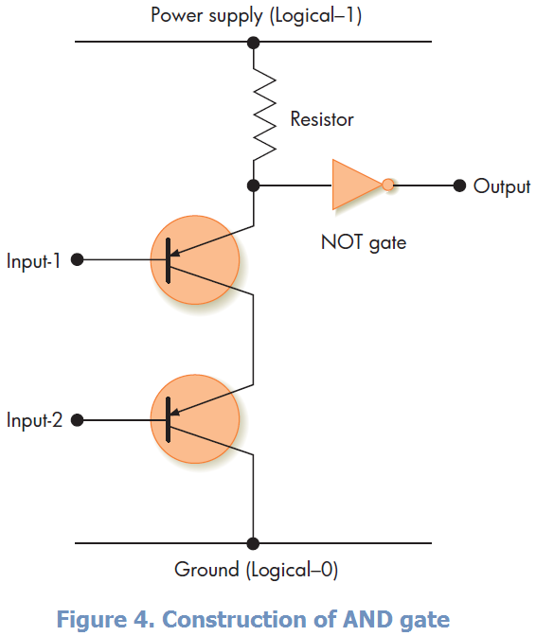
It produces the complement of the AND operation, and it is an important and widely used gate in hardware design.
If, however, we want to build an AND gate, then all we have to do is add a NOT gate (of the type shown in Figure 2) to the output line.
This complements the NAND output and produces the AND truth table.
Gates

Slide 26
Note that the NAND of Figure 3 requires two transistors, whereas the AND of Figure 4 requires three.
This is one reason why NAND gates are widely used to build computer circuits.
Gates

Slide 27
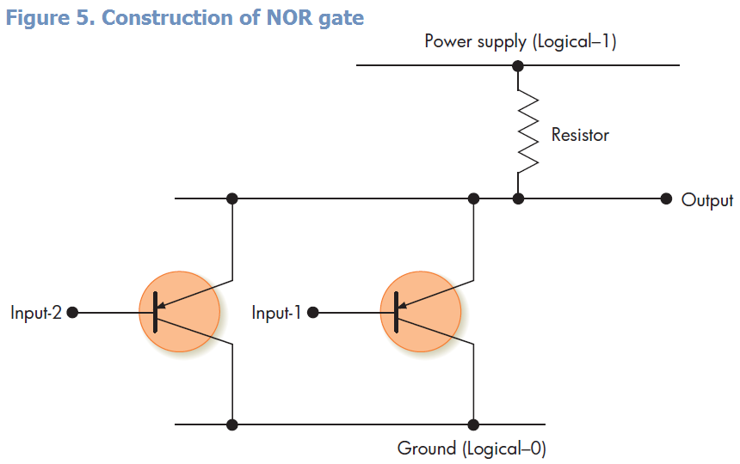
OR Gate
To construct an OR gate, we again start with two transistors. However, this time they are connected in parallel rather than in series, as shown in Figure 5.

Slide 28
In Figure 5 if either, or both, of the lines Input-1 and Input-2 are set to 1, then the corresponding transistor is in the ON state, and the output is connected to the ground, producing an output value of 0.
Only if both input lines are 0, effectively shutting off both transistors, will the output line contain a 1.
Again, this is the exact opposite to the definition of OR given before.
Figure 5 is an implementation of a NOR gate, an acronym for NOT OR.
Gates

Slide 29
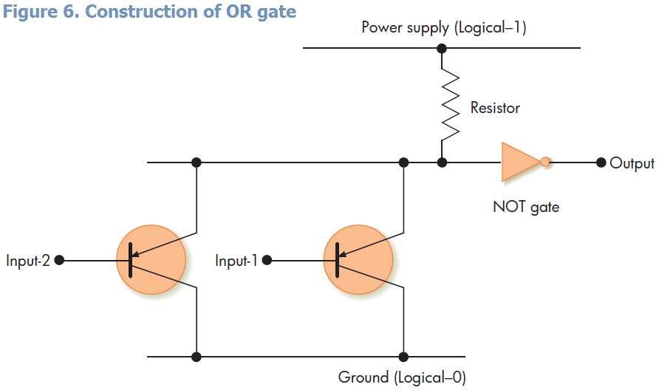
To convert this to an OR gate, we do the same thing we did earlier — add a NOT gate to the output line. This gate is diagrammed in Figure 6.

Slide 30
Gates of the type shown in Figures 2 through 6 are actual electronic devices that serve as the building blocks in the design and construction of modern computer systems.
The reason for using gates rather than transistors is that a transistor is too elementary a device to act as the fundamental design component.
It requires a designer to deal with such low-level issues as currents, voltages, and the laws of physics.
Gates

Slide 31
Transistors, grouped together to form more powerful building blocks called gates, allow us to think and design at a higher level.
Instead of dealing with the complex physical rules associated with discrete electrical devices, we can use the power and expressiveness of mathematics and logic to build computers.
This seemingly minor shift (from transistors to gates) has a profound effect on how computer hardware is designed and built.
Gates

Slide 32
From this point on in our discussion of hardware design, we no longer need deal with anything electrical.
Instead, our building blocks are AND, OR, and NOT gates, and our circuit construction rules are the rules of Boolean logic.
This is another example of the importance of abstraction in computer science.
Gates

Slide 33
Thank You for Attention

